Slide 1

SAFE TRACK :- EMPOWERING WOMEN SAFETY
THROUGH TECHNOLOGY
INTRODUCTION :
SAFETRACK IS A REVOLUTIONARY APP DESIGNED TO ENHANCE THE SAFETY OF WOMEN
BY ALLOWING LOVED ONES TO TRACK THEIR WHEREABOUTS WITH PERMISSION
Importance:
IN A WORLD WHERE SAFETY IS A GROWING CONCERN, TECHNOLOGY CAN PLAY A CRUCIAL
ROLE IN PROVIDING PEACE OF MIND FOR FAMILIES AND FRIENDS.
AUTHORIZED USER SCENARIOS :
PROBLEM STATEMENT:
CURRENT CHALLENGES: WOMEN OFTEN FACE SAFETY THREATS IN VARIOUS SITUATIONS,, LEADING TO ANXIETY FOR THEMSELVES AND THEIR FAMILIES.
SCENARIO-1 : USING THIS APPLICATION A PARENT CAN ACCESS THEIR CHILDREN LOCATION AT ANY TIME,
ESPECIALLY AT LATE NIGHTS.
SCENARIO-2 : HUSBAND CAN TRACK THEIR LOVED WIFE AT JOURNIES.
SCENARIO-3 : A BROTHER CAN TRACK THEIR WORKING SISTER AFTER OFFICE TIME.
[ FIRST IF WE KNOW THE LOCATION IMMEDIATELY WHERE THEY ARE RESCUE THEM BEFORE DISASTER BECOMES EASY]
STATISTICS:
60% OF WOMEN REPORTED FEELING UNSAFE WALKING ALONE AT NIGHT IN THEIR LOCAL
AREA (GALLUP).
75% OF PARENTS EXPRESS ANXIETY ABOUT THEIR CHILDREN'S SAFETY WHEN THEY ARE OUT,
ESPECIALLY DURING LATE HOURS (NATIONAL SAFETY COUNCIL).
LOSING MORE THAN 50% OF WOMEN’S LIFE IN EMERGENCY SITUATIONS
CAUSE OF UNABLE TO FINDING THE LOCATION ON TIME
FEATURES OF SAFE TRACK:
IF THY ARE LATE AT NIGHT NO NEED TO WORRY NOW TRACK THEIR LOCATION AS SIMPLE AS PHONE CALL. IF YOU FEEL SOMETHING HAPPENING WRONG SHARE THAT LOCATION TO YOUR RELATIVES & GO NEAR BY LOCATION
IF YOU DECLARE YOURSELF SOMETHING WRONG HAPPENING...WE ALSO PROVIDED EMERGENCY IN APP TOUCH THAT ICON & GIVE TRACKER NUMBER THEN IMMEDIATELY EMERGENCY MESSAFE WILL SENT TO SAFE TRACK ORGANIRATION & POLICE AUTHORITY THEY WILL DO THEIR WORK OF RESCUING PEOPLE.
TIME COMPLEXITY REDUCES HERE RESCUING POSIBILITY INCREASES...
SOLUTION FOR THE PROBLEM STATEMENT :
INTRODUCTION TO SAFE TRACK
A MINI SIZE (SIM CARD SIZE) TRACKER WILL BE INSTALLED IN MOBILE PHONE, KEY CHAIN,
LOCKETS, ETC.. OTHER POCKET ACCESORIES
BASED ON THE USER SELECTION OF OBJECTS INSTALLATION WILL BE DONE
BRIEF INFORMATION AOUT SAFE TRACK :-
AFTER INSTALLATION IT ASKS USER TO WHO CAN TRACK HIM / HER
OFF TRACK / ON TRACK OPTION: -
USER CHOICE: -
BASED ON THE USER ACCEPTANCE AUTHORIZED USERS CAN ACCESS MAIN USER LOCATION.
[ LIMITATION :- ONLY 10 MEMBERS HAVE CHANCE TO ACCES THE LOCATION ]
THE USER DECIDED TO GO SOMEWHERE BUT HE / SHE NOT INTERESTED TO SHARE HIS / HER WHEREABOUTS AT THAT TIME.... SIMPLY THE CAN OFF THE TRACKER IN APP( THEN AUTHORIZED USERS CAN'T TRACK THE LOCATION OF MAIN USER)....AFTER THAT WORK AGAIN OPEN THE APP AND ON THE TRACKER IT IMMEDIATELY ACTIVATES..
USER MUST ALLOW TO ACCESS THE HIS / HER LOCATION BY SAFE TRACK TEAM
AND POLICE DEPARTMENT.
USER CAN GIVE ACCESS TO TRACK HIS / HER LOCATION AT ANYTIME TO THEIR TRUSTED ONE
LIKE PARENTS, SISTER, BROTHER AND OTHERS.
EMERGENCY PANIC BUTTON: -
HOW TO TRACK :-
[ TRACKING IS TO SIMPLE AS LIKE PHONE CALL ]
IF THE MAIN USER IS FEELING SOMETHING WRONG IS HAPPENING PRIORLY.. WE PROVIDED AN EMERGENCY PANIC BUTTON.
IF THE MAIN USER TAPS THE BUTTON IMMEDIATELY AN EMERGENCY MESSAGE WILL BE SENT TO AUTHORIZED USERS IN 3 DIFFERENT LANGUAGES IN BOTH AUDIO AND TEXT FORMAT ( OF THEIR SELECTED LANGUAGES AT THE TIME OF INSTALLATION) .
STEP-1 OPEN THE APP.
STEP-2 GO TO THE DIAL PAD
STEP-3 WE WILL PROVIDE 10 DIGIT TRACKER NUMBER....SIMPLY DIAL THAT NUMBER.
STEP-4 TOUCH THE TRACK ICON IT GIVES YOU THE EXACT LOCATION OF THE MAIN USER

Slide 2

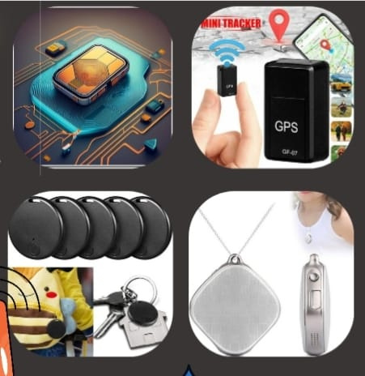
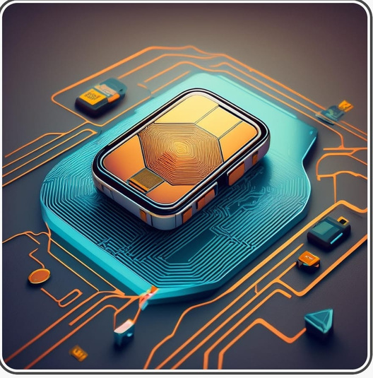
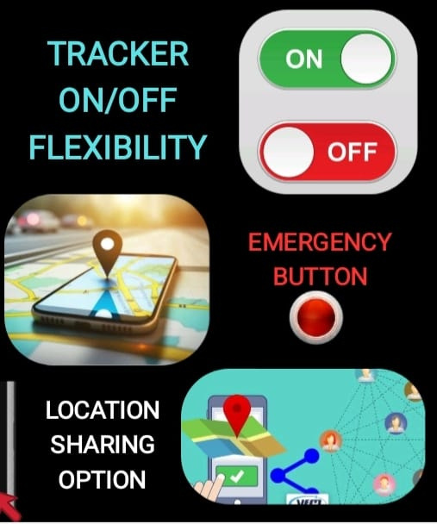


TECHNICAL IMPLEMENTATION : TECHNOLOGY STACK :
FUNCTION: GLOBAL POSITIONING SYSTEM (GPS) ALLOWS FOR ACCURATE REAL-TIME LOCATION TRACKING. IT USES SATELLITES TO DETERMINE THE DEVICE'S LOCATION ANYWHERE ON EARTH.
APPLICATION: THE MINI TRACKER WILL UTILIZE GPS TO PROVIDE PRECISE LOCATION DATA TO AUTHORIZED USERS THROUGH THE APP.
DATA PRIVACY: EMPHASIZE THAT LOCATION DATA IS ENCRYPTED AND SHARED ONLY WITH AUTHORIZED USERS, ENSURING USER PRIVACY IS PRIORITIZED.
COMPETITION: -
THERE ARE FEW WOMEN SAFETY APPLICATIONS AVAILABLE IN THE MARKET LIKE DISHA ETC.. BUT THERE USER RESPONSE IS REQUIRED.. BUT IN SAFE TRACK APPLICATION WE BUILTED MORE FLEXIBILITIES IT WORKS WITHOUT USER RESPONSE ALSO IT WORKS WITH USER RESPONSE..
REVENUE GENERATION :-
TRACKER COST - 2000/- TO 3000/- ( 2 TRACKERS PROVIDED WITH FREE INSTALLATION).
APP SUBSCRIPTION: -
PLANS:-
50/- PER MONTH
300/- PER 6 MONTHS
600 /- PER YEAR.
COLLABORATIONS...ETC
BY :
DIGITAL DREAMERS

